Slide 1


MAHENDRA ENGINEERING COLLEGE (Autonomous)
CATCH ‘25 – Hackathon
Name of the College : Mahendra Institute of technology
Name of the Team :FURIOUZ CODE
Name of the Team Leader : IMRAN.S.S
Name of the Department : CSE
Problem Statement : AI-POWERED TRAFFIC MANAGEMENT SYSTEM
Date : DD/MM/YYYY

Slide 2
CREW DETAILS
NAME OF THE STUDENT | YEAR | DEPARTMENT | DESIGNATION | E MAIL ID
IMRAN.S.S | II | CSE | TEAM LEADER | Imranss1309@gmail.com
KISHORE KUMAR.V | II | CSE | CODER | Kishorekumarv25@gmail.com
KALIDASH.M | II | CSE | SUB LEADER | kalidhas00004@gmail.com
LOGESHWARAN.M | II | CSE | CODER | logeshm15112005@gmail.com
KATHIRAVAN.E | II | CSE | TEAM MEMBER | kathiravankathiravan2305@gmail.com
*For Example Contribution Type Can be : Coder, Team Leader, Team Member.

Slide 3
MODULE LIST
ABSTRACT
IDEA/APPROACH DETAILS
FLOW CHART
TECH STACK AND DEPENDENCIES
METHODOLIGIES OR ALGORITHMS FOCUSED
ANALYSIS PART OF THEIR PROJECT
EXPECTED OUTCOME
SOCIAL RELEVANCE
CONCLUSION AND FUTURE WORK

Slide 4
ABSTRACT
Problem Statement:210
Traditional road safety education lacks engagement and innovation, resulting in poor awareness and unsafe practices
Objective :
To develop an engaging gamified platform leveraging AR technology and community participation to enhance road safety education.

Slide 5
IDEA/APPROACH DETAILS
Novelty
Contribution
Combiens gamification,AR technology,
and rewards to create
A resolution road safty education system
Increase awareness,encourages safer habits and provide an engaging
Platform to learn road safty.
Execution Difficulties:
EXPECTED
Outcomes
Increased Engagement:
Road safety education becomes fun and interaction
Improved Awareness:
Effective understanding of traffic rules across age groups.
BehavioralChanges:Community adapts to safer road habits
Scalable Model: Application to various demographics and communities.
TECHNICAL CHALLENGE
Initial cost for AR development and 3D assets
COMMUNITY COLLABORATION
Onboarding business for rewards
Complexities
In integrating AR with flutter
Encouraging users to report unsafe practices

Slide 6
FLOW CHAT
FRONTEND LAYER(UNITY)
Leader boards(points)
Quiz engine(UI)
AR-simulation Access(IL)
Authentication
(firebase)
BACKEND LAYER
Cloud function
(server-side)
AR-module
(unity foundation )
*REWARD*
Deployment (googleplaystore,Microsoft)
Analytic Layer
(behavior)

Slide 7
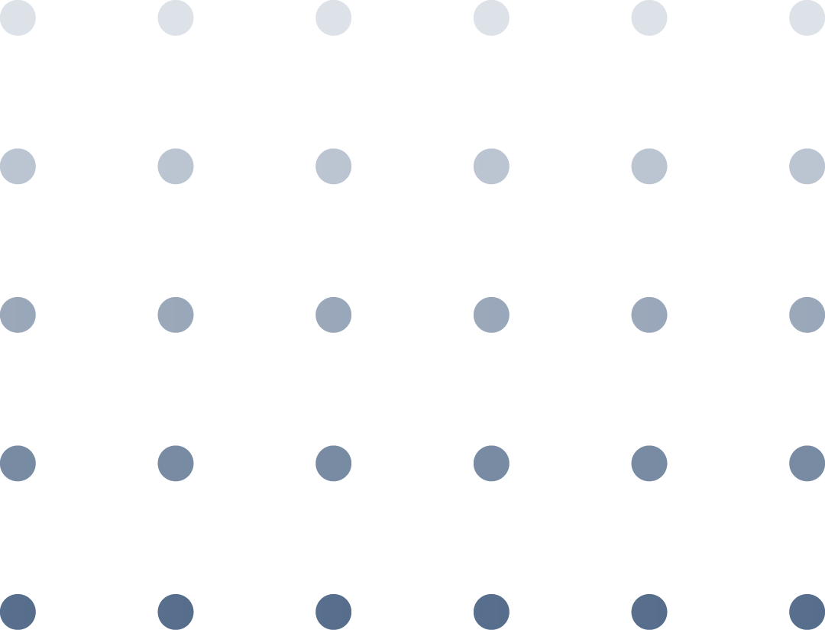
METHODOLIGIES OR ALGORITHMS FOCUSED
Community Engagement
Reporting unsafe practices to promote proactive safety behavior.
Gamified Learning Modules
Interactive quizzes tailored to various difficulty levels.
AR-Based Simulations
Virtual scenarios for practicing safe driving and pedestrian habits.
Leaderboards and Rewards
Foster healthy competition and incentivize participation.

Slide 8
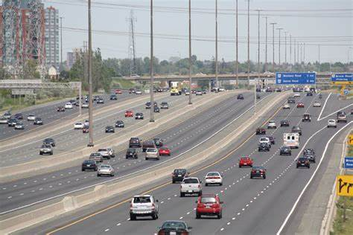
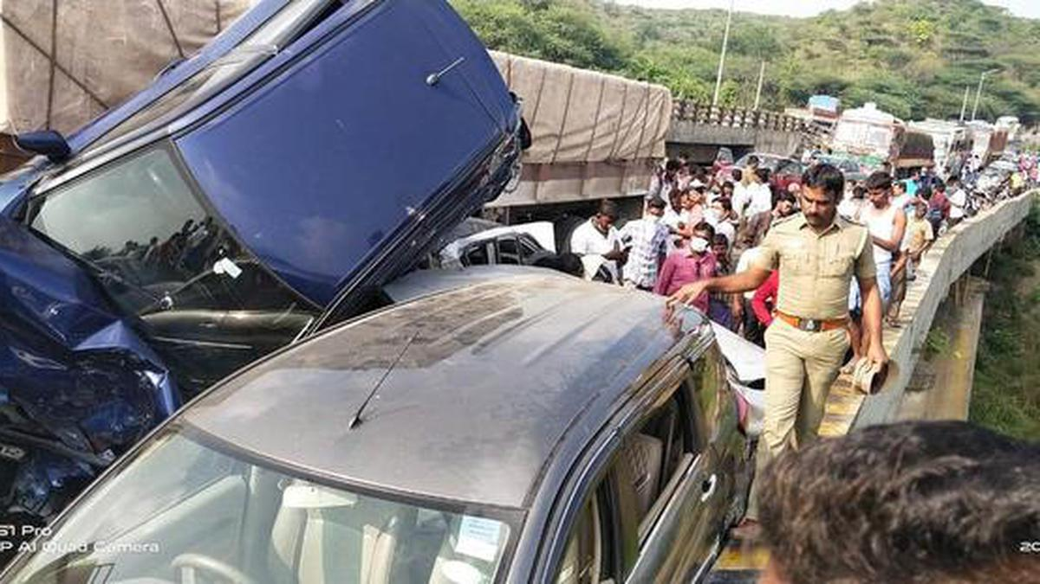
ANALYSIS OF THE PROJECT
AFTER AWARE:
But our 3D model we will
gave a complete aware.
The can make to do our state
accident free.
BEFORE AWARE:
The people didn’t know about the how the accident occur .
What we do mistake to occur a accident.

Slide 9


EXPECTED OUTCOME
. Our main reason for making a model to aware
a people what we do what we doesn’t do.
. And also we will show his future by making a
3D model
.We are choosing a design because all are
entertain by using the mobile phone it will reach
to all.
.We can turn into AI develop in future.

Slide 10
SOCIAL RELEVANCE
The people get accident
1.Natural
2.Man made
Natural means the vehicle can accident by break failure or other issue in the vechicle
Man made is the pepole didn’t aware about how to react the sings in the road it was the main reason pepole do accident
Our app used to say how to follow the road rules and what we do what we can’t do.

Slide 11


CONCLUSION AND FUTURE WORK
At the conclusion we gave aware to the people how to drive a vehicle safe and follow the traffic rules.
FUTURE WORK
By using the Ai technology the can work like a google maps .
The can before 7km what the board is near to us and it gave the complete solution what we do what we didn’t do
The was very useful and get develop in future.

Slide 12
THANK YOU !

